Slide 1

Targeting Marketing Campaigns
30th April
Notes:
The Digital Transformation is here to change our life. A new environment is growing: connected, intelligent, complex.
Process is now digital and connects People and Products with each other or with information.
Technology enables new paradigms of communication, people and machine will be connected more than ever.
Our Society will disrupt old business models. Our cities will be sensorized, human communities will become smart.
But we will face a new pervasive threat environment: CyberSpace without SECURITY could become a Digital Jungle, Cybercrime is threatening Trust.
Cybersecurity should be a trust multiplier framework to manage Technology Risk.

Slide 2



Where needs meet data
One size doesn´t fit all
Intrusive
Low ROI:
Extra Expenditure
Low conversion
Additional Services:
Predict and classify the type of customer based on the phone usage, further on selling this service to marketing companies to increase ROI of their client´s online campaigns
Apps usage (inst. vs. active)
Demographic data
Phone brands
Notes:
http://techblog.netflix.com/2013/03/system-architectures-for.html
http://www.nytimes.com/2016/11/10/technology/the-data-said-clinton-would-win-why-you-shouldnt-have-believed-it.html

Slide 3

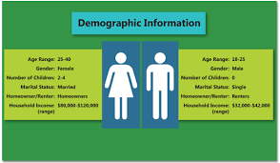
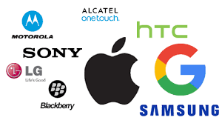
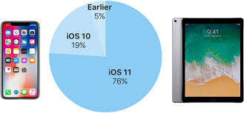

Data from the mobile operator
Event:
Event_id,
Timestamp,
location,
device id
Phone brand:
Device_id
Phone brand
Phone model
Gender age train:
Device_id
Age
Gender
Group
Device_id
App_id
Installed or active
186k
2.3m
App Events:
Event_id
App_id
Installed or active
5.6m
Final Dataset
Age
Gender
Groups (12)
App Category
Phone Brand
Installed or active
App label:
App_id
App_category
2.3m
40k
Notes:
http://techblog.netflix.com/2013/03/system-architectures-for.html
http://www.nytimes.com/2016/11/10/technology/the-data-said-clinton-would-win-why-you-shouldnt-have-believed-it.html

Slide 4
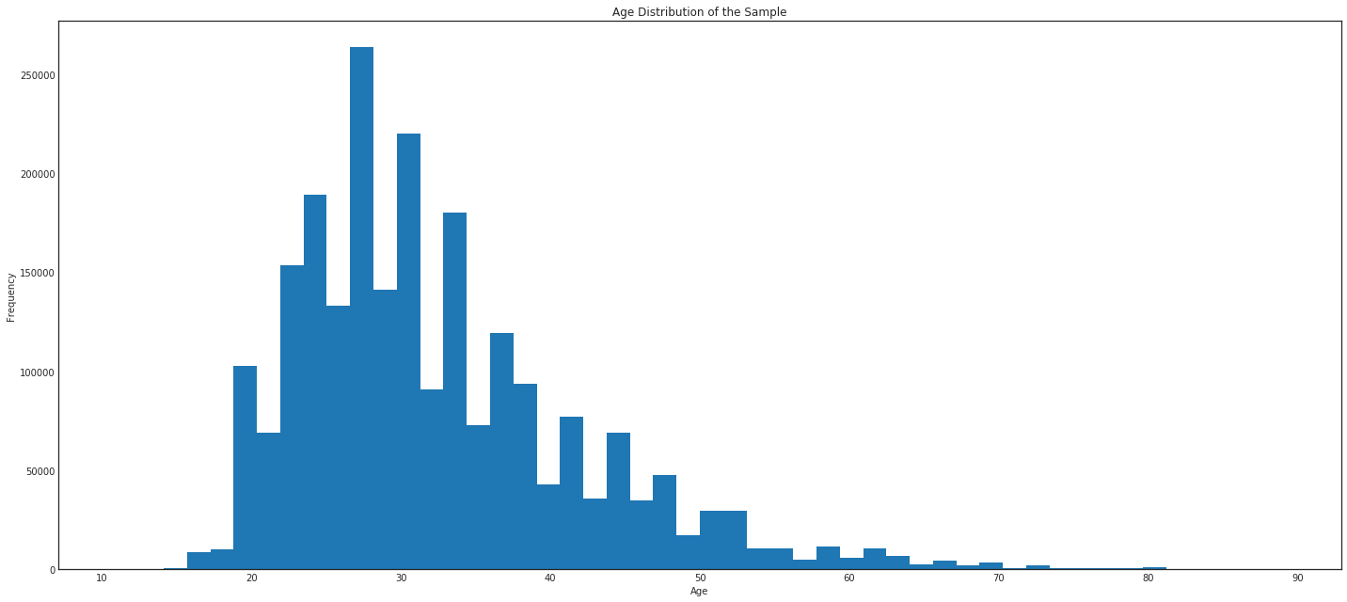
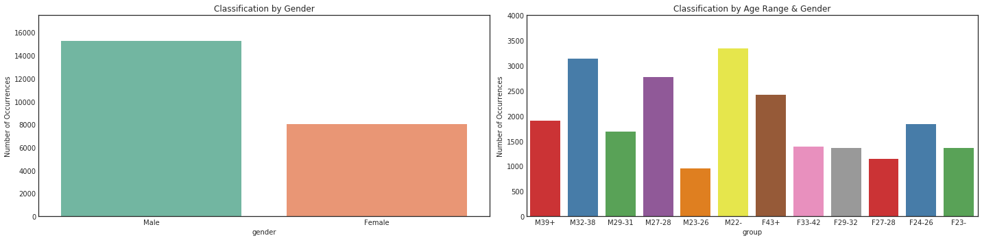
Exploratory Data Analysis (I of III)
15600
48%
8000
From the information provided by the mobile operator, the median age is 29 years being 34% female and 66% male:
The population contained in the interquartile ranges between 25 and 65 being a clear imbalance in the groups provided by the mobile operator
Only 34% of the sample is female which will aslo imbalance the target groups
Notes:
http://techblog.netflix.com/2013/03/system-architectures-for.html
http://www.nytimes.com/2016/11/10/technology/the-data-said-clinton-would-win-why-you-shouldnt-have-believed-it.html

Slide 5
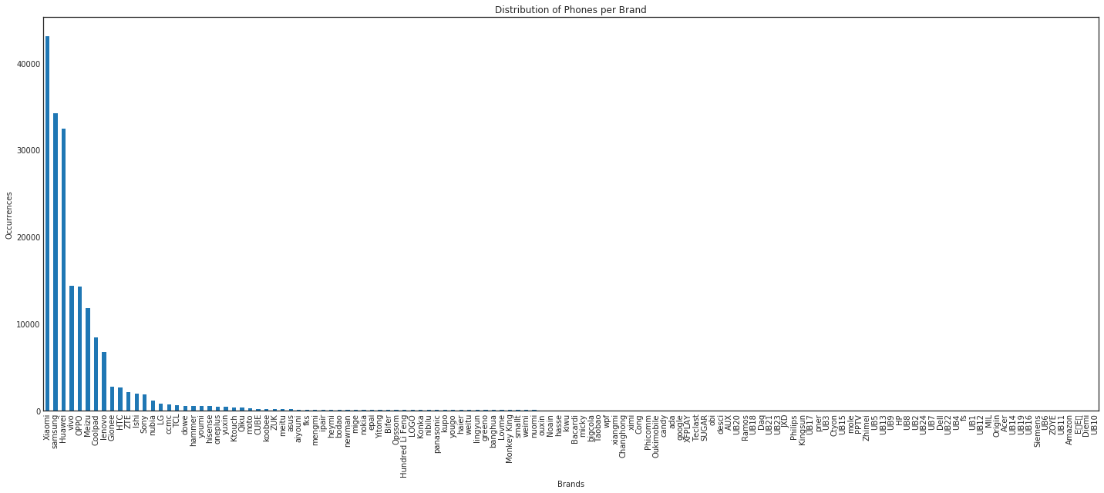
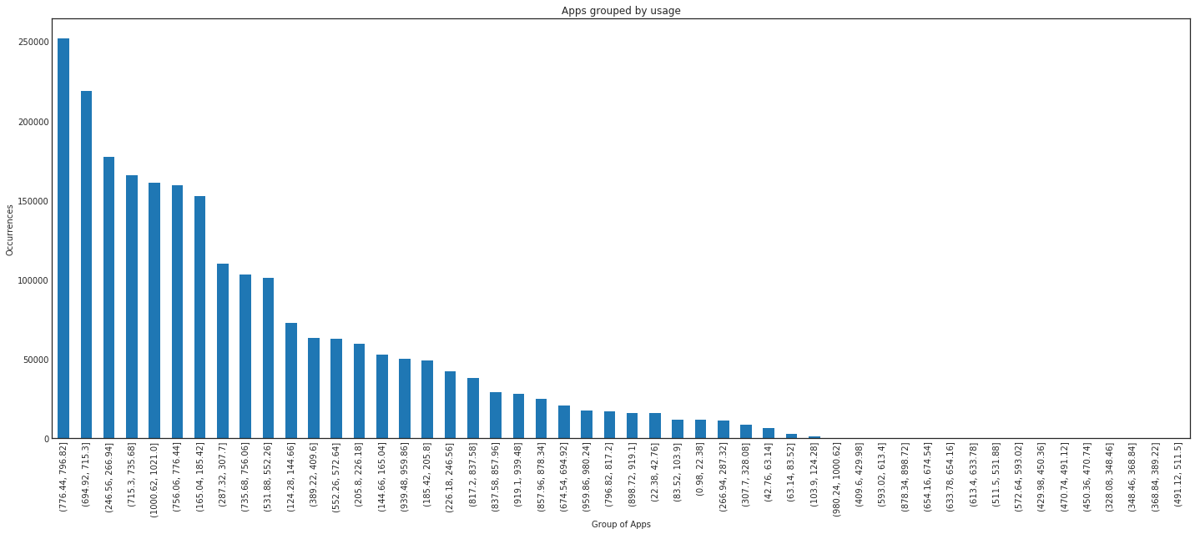
Exploratory Data Analysis (II of III)
The data follows in apps and brands the 80/20 rule: 20% of the apps and pone brands represent 80% of the sample:
From an apps usage standpoint, the most important group of apps according to its usage corresponds to financial, lottery and gaming apps followed by apps related to smart appliances and wearables in second place. The third place is taken by the apps used for banking and payment services. On the lower end the apps that show a smaller usage are the leisure related ones like photography, wedding planners or trips abroad.
From a phones standpoint, eight brands represent 90% of the sample.
Notes:
http://techblog.netflix.com/2013/03/system-architectures-for.html
http://www.nytimes.com/2016/11/10/technology/the-data-said-clinton-would-win-why-you-shouldnt-have-believed-it.html

Slide 6
Exploratory Data Analysis (III of III)
From a data analysis perspective, the data that has been given is unbalanced between the groups that will be used to classify. The groups male lower than 22 and the group between 32 and 38 are the ones that contain most of the population:
Target groups: 'M39+‘, 'M32-38', 'M29-31', 'M27-28', 'M23-26','M22-', 'F43+', 'F33-42', 'F29-32', 'F27-28', 'F24-26', 'F23-‘
The groups need to be resampled before the model selection is run and parameters are selected
This resampling technique that has been chosen is to upsample the minority increasing the final number of datapoints up to 40k.
Male between 23 and 26 are the group will less datapoints in the dataset
Notes:
http://techblog.netflix.com/2013/03/system-architectures-for.html
http://www.nytimes.com/2016/11/10/technology/the-data-said-clinton-would-win-why-you-shouldnt-have-believed-it.html

Slide 7
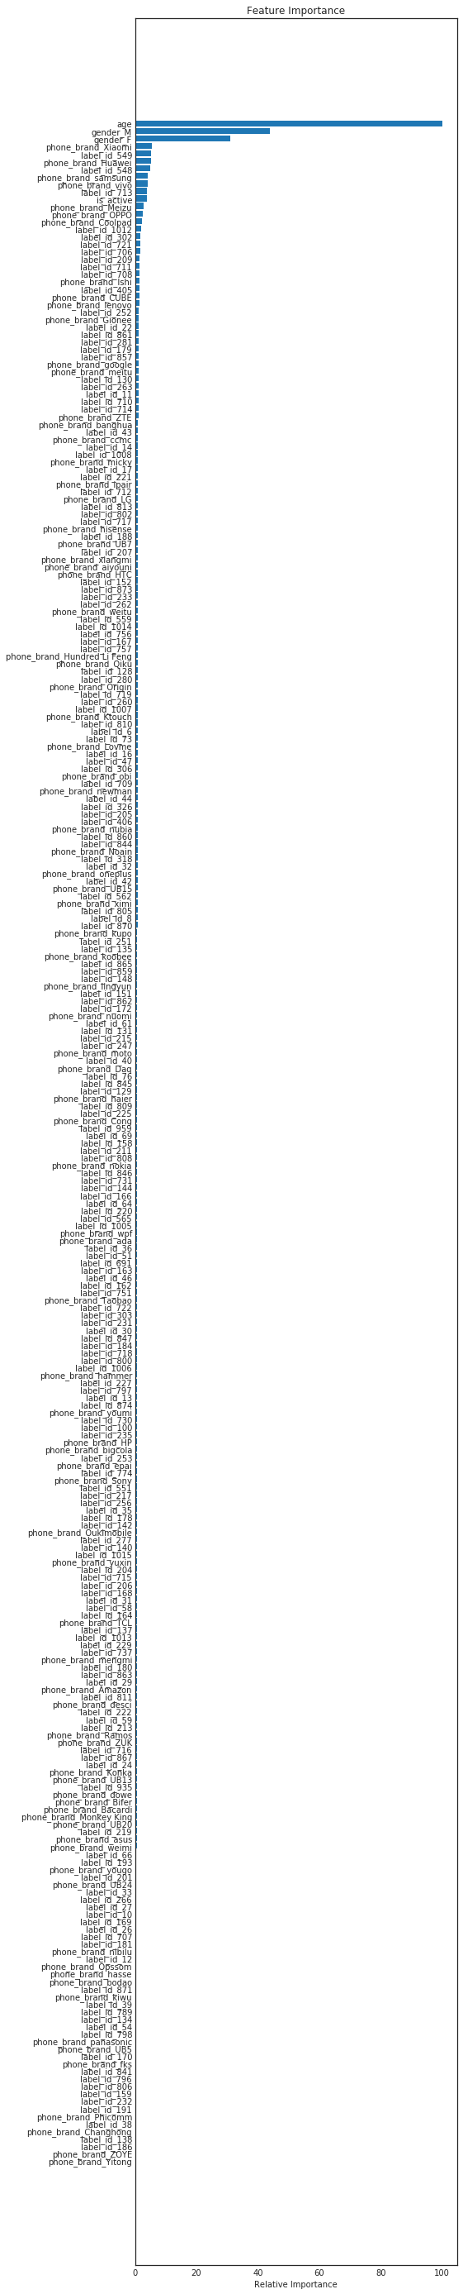
Feature Selection
Features don´t show correlation greater tan 40% (either way). From an initial PCA analysis, 120 PC out of 274 features explain 97% of the variance which equates to a score greater than 10 according to kbest.
Data has been preprocessed and scaled to a standard normal distribution N(0,1)
Potential features present low correlation and there is no feature in the datset that presents a correlation higher thn 40%.
Once the feature selection is analysed and PCA carried out only 120 features out of the 274 are used
In this case the features obteind using PCA will be used to achieve the highest accuracy in the 12 classes classifier
Although the PCs cannot be traced back to the original features, we need to make sure that we are targeting the right population, hence there is no need for using the initial features.
Notes:
http://techblog.netflix.com/2013/03/system-architectures-for.html
http://www.nytimes.com/2016/11/10/technology/the-data-said-clinton-would-win-why-you-shouldnt-have-believed-it.html

Slide 8
Model Selection (I of II)
Algorithm | Hyper-parameters
Naïve-Bayes | Alpha = 10
Logistic Regression | C = 1000, Penalty = L2
Kneighbors Classifier | Neighbors = 5, Weights = distance
Stochastic Gradient Descent | Alpha = 0.0001, Loss = hinge
Support Vector Machine | C = 1000, Kernel = rbf
Linear Support Vector Machine | C = 100, Loss = hinge
Random Forest | Estimators = 170, Depth = 31
Gradient Boosting | Estimators = 190, Min simple split = 3, Depth = 50
To solve the multiclass classification problem with the maximum overall accuracy, algorithms have been tuned on the training set using the overall accuracy as the model selection strategy. Once tuned, computational effort has also been measured
Hyper-parameters tuning has been done on the training set (70% of the Data set) considering “accuracy” as the scoring method since missclassification is equally bad in both directions (false positivies or negatives).
Computational effort has been measured considering the time required by the model to fit the test set and run cross validation with 5 folds.
Notes:
http://techblog.netflix.com/2013/03/system-architectures-for.html
http://www.nytimes.com/2016/11/10/technology/the-data-said-clinton-would-win-why-you-shouldnt-have-believed-it.html

Slide 9
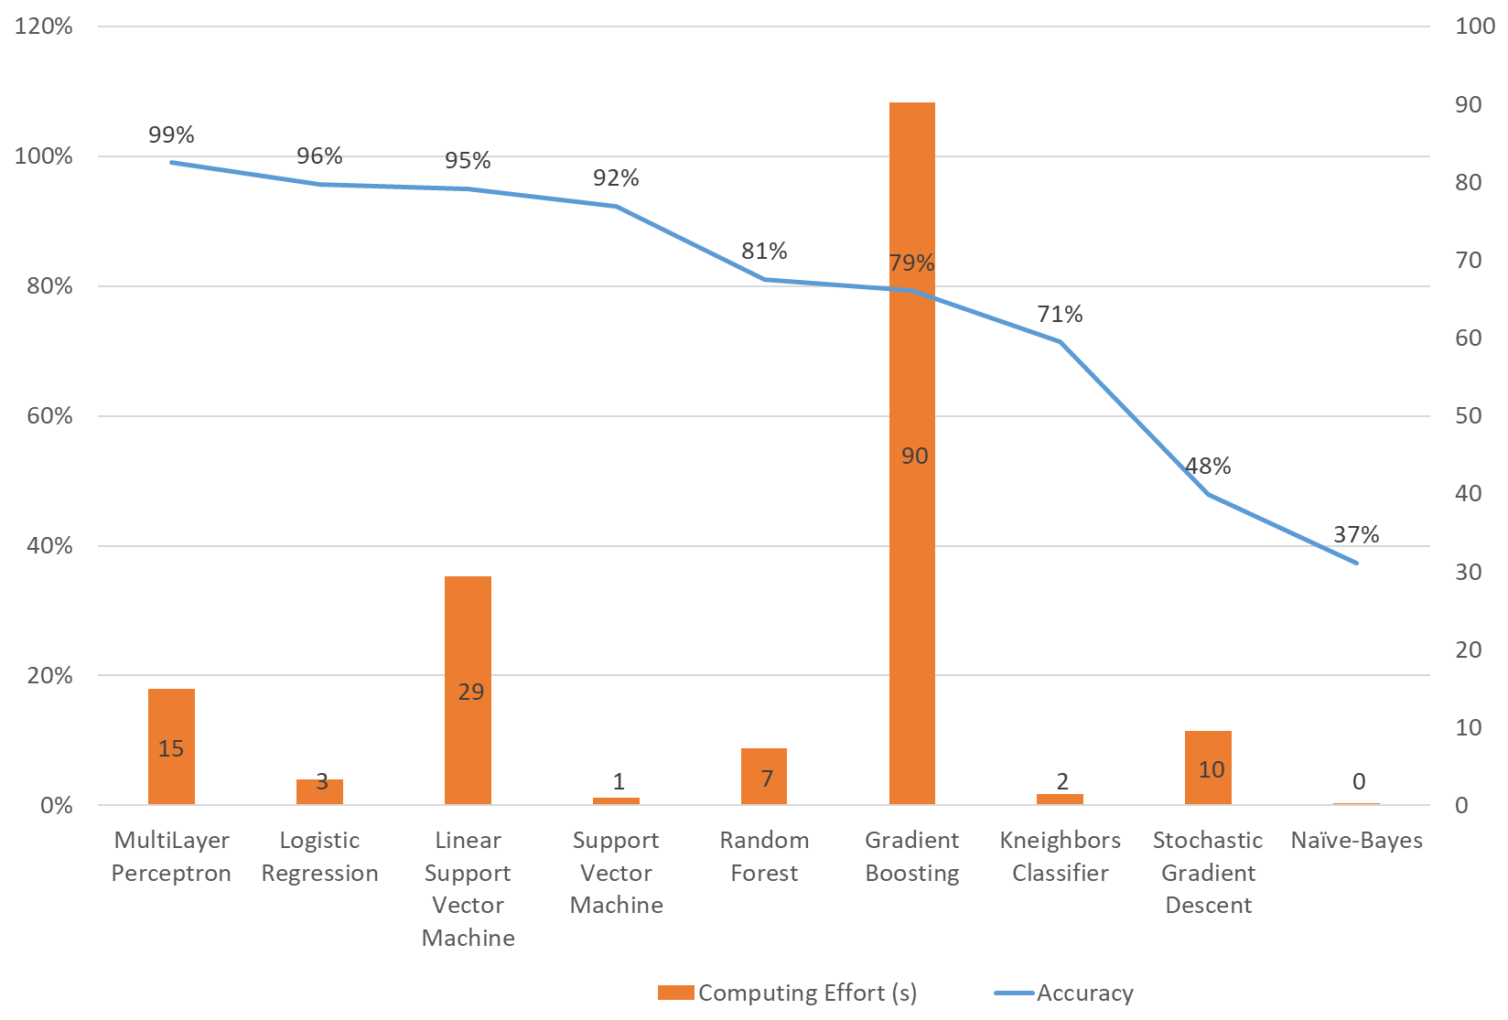
Model Selection (II of II)
From an orverall accuracy and computational effort standpoint, Multilayer Perceptron and Logistic Regression are the two models that require less computational effort and present a higher accuracy. From the two, Logistic Regression is the strongest candidate for production
Naïve-Bayes, Kneighbors present a lower accuracy tan expected due to the dimension of the problem. Points to appear to be close can be scattered due to the high dimension of the problema 120 dimensions.
Linear Vector machine, although better from a sclability perspective than SVM requires more time. In this case the way in which the features have been generated make SVC more suitable as the data has been already projected when using PCA and the C parameter allows more “errors” when classifying.
Notes:
http://techblog.netflix.com/2013/03/system-architectures-for.html
http://www.nytimes.com/2016/11/10/technology/the-data-said-clinton-would-win-why-you-shouldnt-have-believed-it.html

Slide 10
Clustering
Meanshift clusters
Silhouette score comparison (Spectral vs Kmeans clustering)
Different clustering have been used to see the different ways in which the data could be clustered to extract meaningful insights. Affinity propagation was discarded as the number of clusters is over 14k. Meanshift was also discarded due to the number of clusters for all the values in the bandwidth. Kmeans has been chosen over spectral clustering.
Affinity propagation and meanshift clustering are not valid when applied to the dataset for clustering purposes due to the number of clusters they give as a result
When comparing silhouette scores kmeans clustering is higher for values between 4 and 7. Although the numbers vary with each comparison, it seems to be relatively stable in terms of comparison.
The clustering technique that will be followed is kmeans clustering as the peack in the silhouette score is achieved by kmeans clustering with six clusters.
Notes:
http://techblog.netflix.com/2013/03/system-architectures-for.html
http://www.nytimes.com/2016/11/10/technology/the-data-said-clinton-would-win-why-you-shouldnt-have-believed-it.html

Slide 11
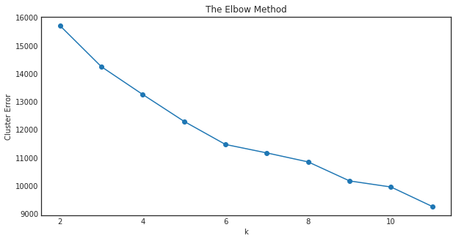
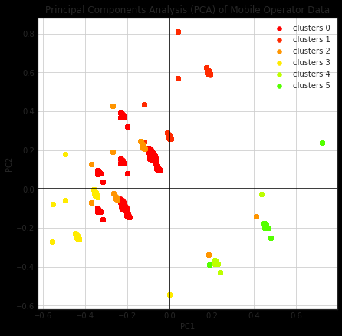
Marketing Insights - Clustering
After cmaring the different clustering techniques, kmeans is the one that seems to be working best. In this case, the number of clusters is 6. Although none of the clustering techniques is giving meaningful information wihint the clusters.
The main apps used between clusters are the industrial and construction apps which explain the characteristics of the population: Highest proportion of men over women and the age distriution
From an age perspective, even when varying the number of clusters, the simple is evenly scattered across samples
The clusters are not stable having different results (and numbers of clusters) every time it has been run.
Notes:
http://techblog.netflix.com/2013/03/system-architectures-for.html
http://www.nytimes.com/2016/11/10/technology/the-data-said-clinton-would-win-why-you-shouldnt-have-believed-it.html

Slide 12
Conclusions
The 274 features initially obtained can be reduced to 120 PCs explaining 97% of the variance through the 120 PCs.
From the categorical data obtained from a mobile operator a demographic classification can be done achieving 95% accuracy
From a production standpoint, the computation effort has being measured in terms of computing time being the logistic regression the best option
Although the Multilayer Perceptron gives a higher accuracy, the higher complexity and the lack of relationship between initial features and results will not make it an adequate candidate for production
The data that has been given represents a sub-segment of the population of the customer base being this one of the reasons why clustering techniques are not adding value.
Notes:
http://techblog.netflix.com/2013/03/system-architectures-for.html
http://www.nytimes.com/2016/11/10/technology/the-data-said-clinton-would-win-why-you-shouldnt-have-believed-it.html

